Slide 1
ZFIVAT001 – VAT report with logistics
Report for analysing VAT results based on their scenarios

Slide 2
Content
Purpose
Implementation
Q&A

Slide 3
Purpose
What is ZFIVAT001 used for?

Slide 4
Purpose
Standard SAP only offers a VAT report with old fashioned ALV grid layout. Even though it can be modified, the number of additional fields which can be added is limited. Analyzing a download is cumbersome because the text file must be modified before it can be used properly.
ZFIVAT001 offers much out of the box functionality for quickly analyzing background information related to VAT, focusing mainly on the sales side but with some information for purchasing as well. Once installed you a have a useful report to analyze background information such as ship-from, ship-to, sold-to, payer, VAT numbers, Incoterms, tax classification and much more.
The report comes with standard ALV, which can be exported to Excel directly or you could schedule the report and let you email the results as well.

Slide 5
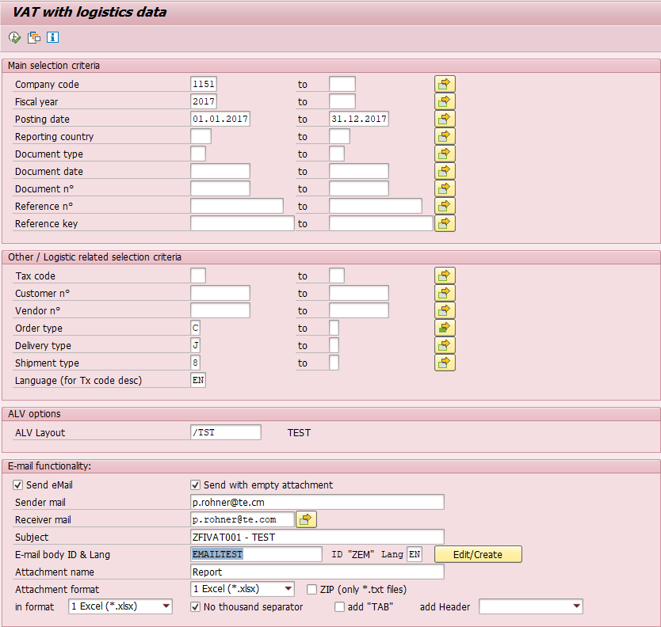
Purpose ct’d
The report is providing you drill-down functionality which you can use to quickly analyze underlying documents, such as sales orders, deliveries, shipments, billing docs etc.
Following a couple of screenshots to give you some ideas.
Selection Screen =>

Slide 6
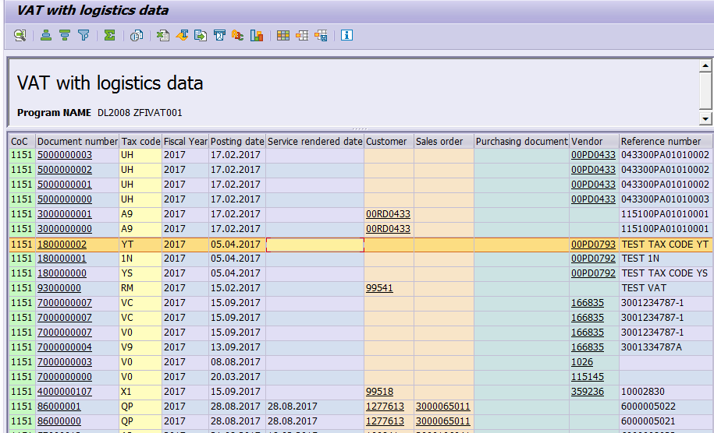
Purpose ct’d
<= Report output
Example download with more fields:

Slide 7
Purpose ct’d
Implemented during August 2020, the program is capable now to gather x-company information. I.e. Intercompany invoice information (accounting document, billing document, tax information etc.) is displayed.
For companies heavily using the x-company functionality, this will make analyses much more easy. This might even be helpful for transferpricing calculations.

Slide 8
Implementation
How to implement the program

Slide 9
Implementation
The program will have to be implemented as a Z-program in your SAP environment. It is NOT a bolt-on. Therefore you would have to maintain it yourself once it got installed. Of course, Rohner – Think Twice can help you with that.
For the implementation, you will get the code and can simply create the program & includes. If you want to start if from a transaction, you can do this with SE93 and you can add it to a custom menu tree using SE43. If you want, Rohner – Think Twice can take over these tasks for you.
Currently the program contains a very limited authority check only. If an enhanced method shall be used, you are allowed to modify the program code for doing this.
ZFIVAT001 only inquires standard SAP tables, no Z-fields etc. Of course, if you are using such fields, e.g. for sales order or billing document, the program can be modfied to include them as well.

Slide 10
Q&A
TBD

