Slide 1
Microsoft SharePoint 2010
Features (highlights)
English version

Slide 2
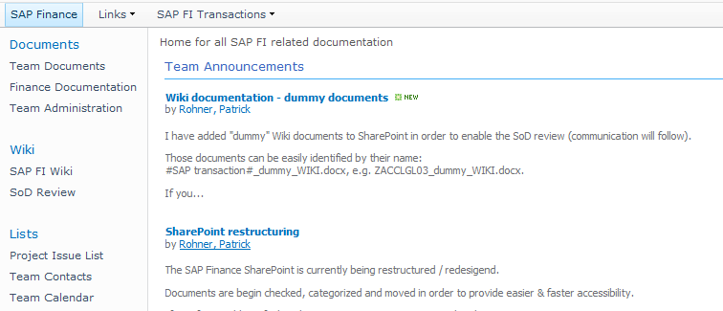
Overview
Document repository:
SharePoint offers a structured way to store your documentation (processes, training documents, manuals and so on)
Below a screenshot from SharePoint with a few standard features, like document libraries (e.g. Finance Documentation), Wiki pages and other Lists (e.g. Project Issue List)

Slide 3
Overview
Search:
Documentation can be found easily & quickly; there are various ways to make documentation available for the users
Collaboration:
Share documents between teams / restrict access to certain groups if required
SharePoint allows users to work together; it is even possible that multiple users work on the same document at the same time.
Information platform – News/ Announcements can be easily published
Workflows
Setup Workflows, e.g. to manage document review processes
Survey
Standard surveys can be easily carried out and analyzed

Slide 4
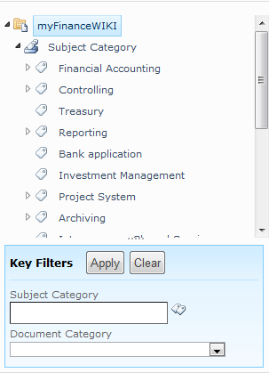
Examples
Using ‘Managed Metadata’ might be a smart way to categorize your documentation and find it again quickly.
It is highly customizable and allows the usage of aliases / synonyms.
The tree structure is similar to a folder structure in your explorer but with the advantage that no folders must be created

Slide 5
Examples
User can be easily notified about newly created or updated documents
Two important ways are possible
Alerts can be set by the users
RSS feeds can be applied and e.g. imported into Outlook for getting news in a convenient way

Slide 6
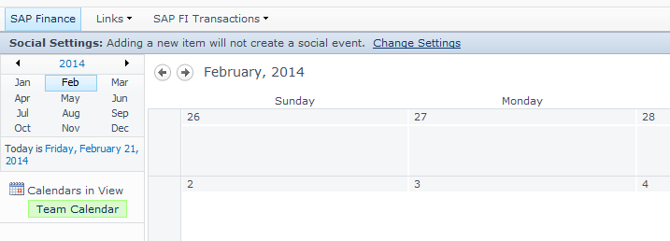
Examples
SharePoint is highly integrated with other Microsoft products, but not only.
Calendar, Tasks, RSS feeds can be managed directly from Outlook
Even non-Microsoft programs like MindJet offer a high integration with SharePoint

